Slide 1
Data Structures

Slide 2
Agenda
Reverse a String
Check if a String is Palindrome
Check if two strings are Anagrams of each other
Check if 2 strings are rotation of each other
Reverse Words in a String

Slide 3
Reverse a String

Slide 4
Reverse a String

Slide 5
Check if a String is Palindrome

Slide 6
Check if two strings are Anagrams of each other

Slide 7
Check if two strings are Anagrams of each other

Slide 8
Check if two strings are Anagrams of each other

Slide 9
Check if two strings are Anagrams of each other

Slide 10
Check if 2 strings are rotation of each other

Slide 11
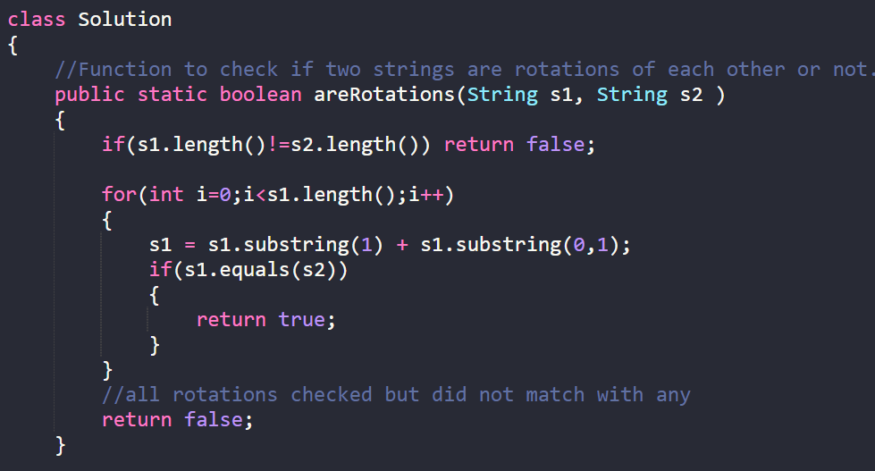
Check if 2 strings are rotation of each other

Slide 12
Check if 2 strings are rotation of each other

Slide 13
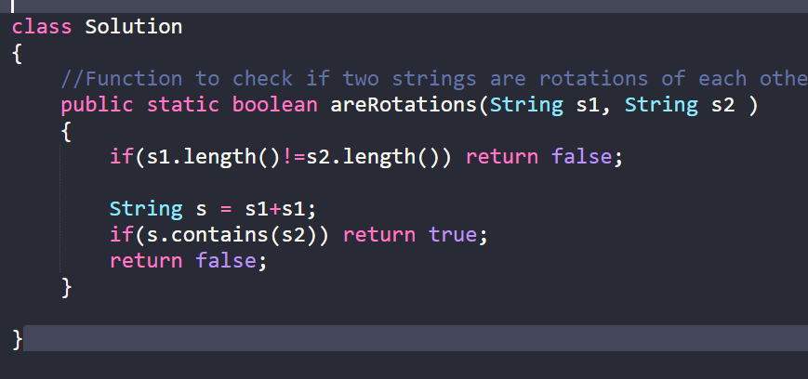
Check if 2 strings are rotation of each other

Slide 14
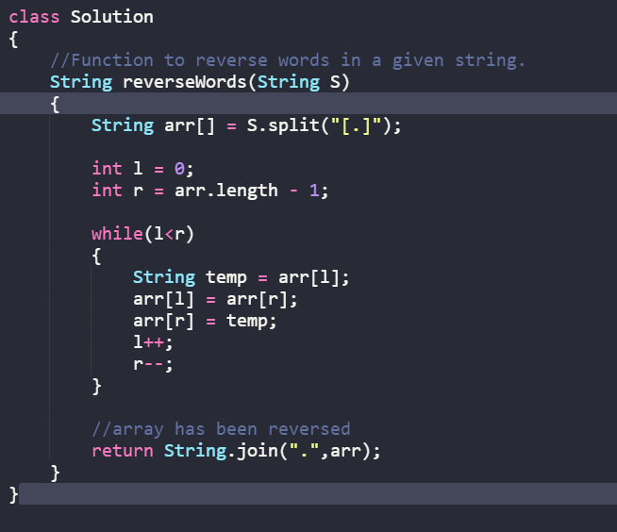
Reverse words in a String
https://practice.geeksforgeeks.org/problems/reverse-words-in-a-given-string5459/1/

Slide 15
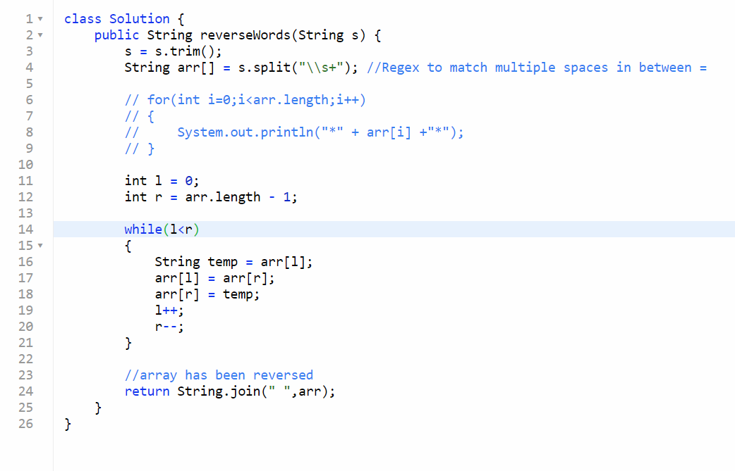
Reverse words in a String
https://leetcode.com/problems/reverse-words-in-a-string/

Slide 16
THANK YOU

